Slide 1
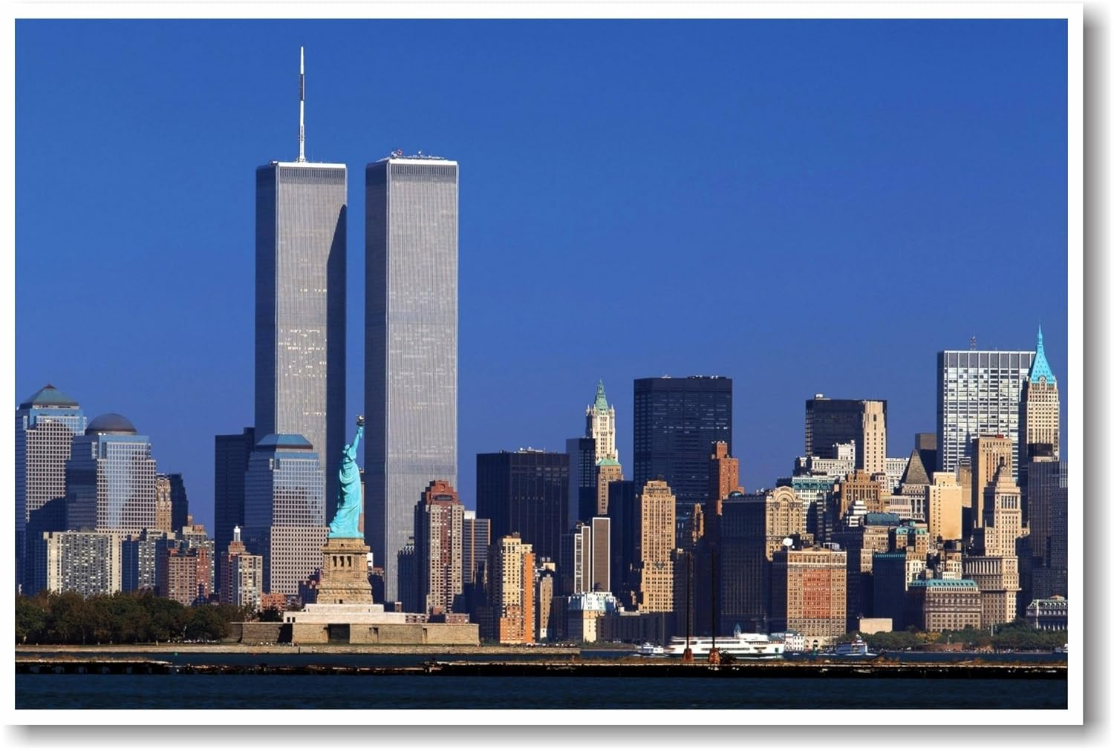
AVIATION ACCIDENT ANALYSIS

Slide 2
BUSINESS UNDERSTANDING
This analysis centers on aviation accidents data from the National Safety Transportation Board , covering accidents from 1962 to 2022
To help your company evaluate the safest options for entering into the aviation industry we used a combination of data cleaning , analysis and visualization techniques to identify patterns in aircraft safety

Slide 3
What we did
We cleaned the data by removing irrelevant records and from nearly 89,000 rows we narrowed it down to 7,200 records with quality information:
TYPE OF AIRCRAFT
MANUFACTURER
NUMBER OF ENGINES
PURPOSE OF THE FLIGHT
INJURIES
We then visualized these factors to explain how they are related

Slide 4
The cleaned and visualized data gives you a clear understanding on which air craft models are associated with fewer injuries and which air craft is a safer investment as you venture into the aviation industry.

Slide 5
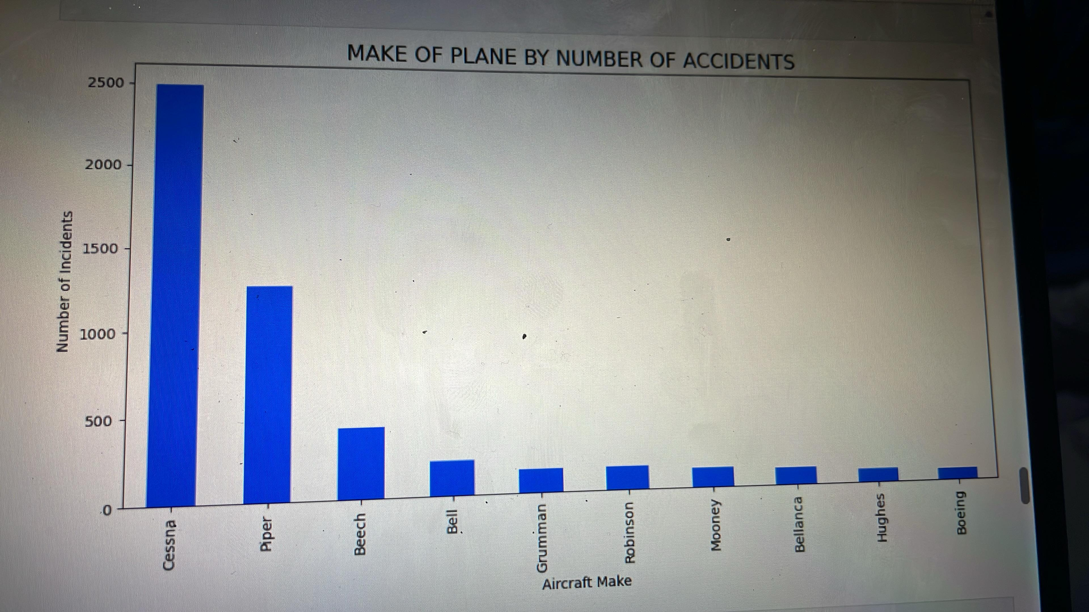

Slide 6
observation
CESSNA and PIPER are two topmost notorious companies which manufactured aircrafts that are involved in accidents as per this dataset hence the safest option to start with a BOEING.

Slide 7
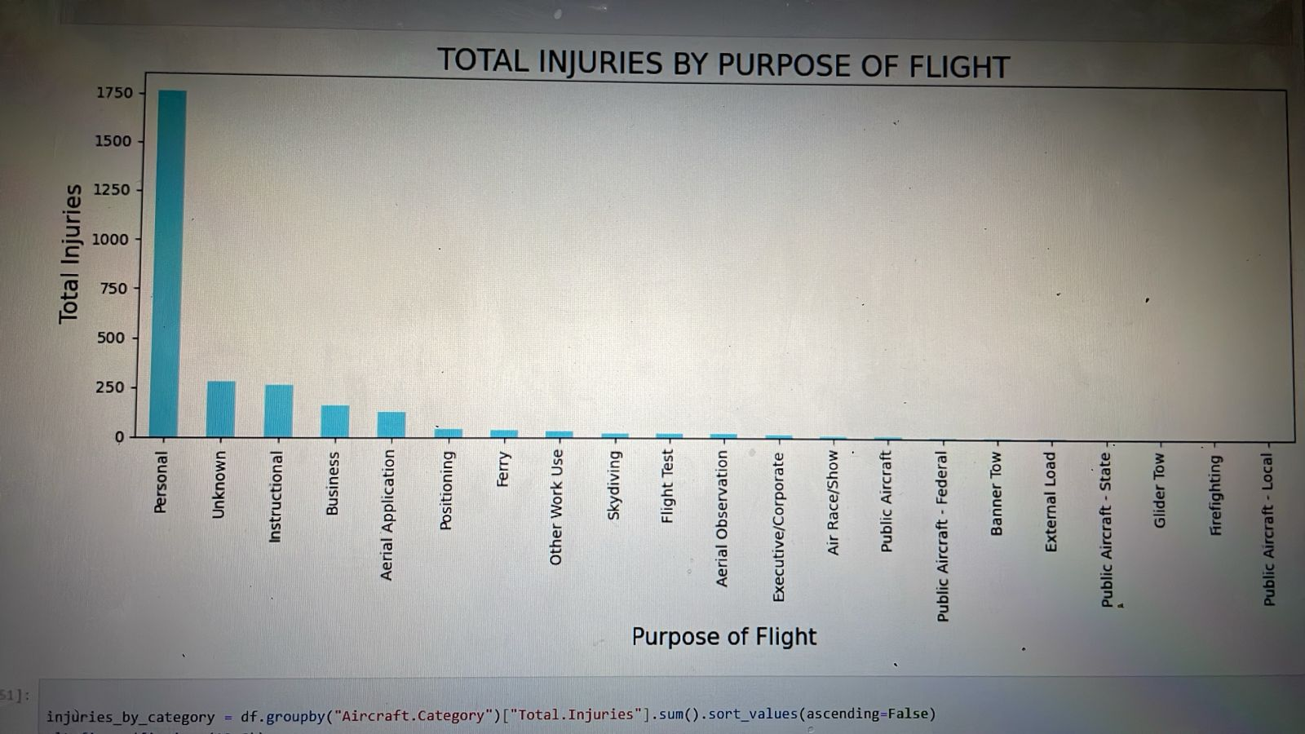

Slide 8
observation
Personal flights are responsible for big portion of aviation accidents. For personal flights, comprehensive education and training programs should be promoted for pilots. Encouraging a safety-first culture within the personal aviation community is essential. Making safety a top priority in all personal flight activities is crucial to reducing accidents. Pilots must be well-prepared and aware of the potential risks associated with personal aviation, regardless of the weather conditions.

Slide 9
RECOMENDATIONS
First plane to purchase should be a Boeing since it has lower accident records
Start with a single engine plane due to lower injury count
Avoid aircraft primarily used in private or non-commercial flights.
Monitor trends using interactive tableau dashboards

Slide 10
CONCLUSION
For any further questions you can :
EMAIL – cjmungai047@gmail.com
or
LinkedIn -- linkedin.com/in/john-mungai-449348368

